Slide 1
5G – Enabling technology?
Shengli Zhang

Slide 2
目录
1
The development of mobile
communication
5
G
Wi
Fi
2
The vision of 5G?
3
Key technologies in 5G?
4
Applications of 5G.

Slide 3
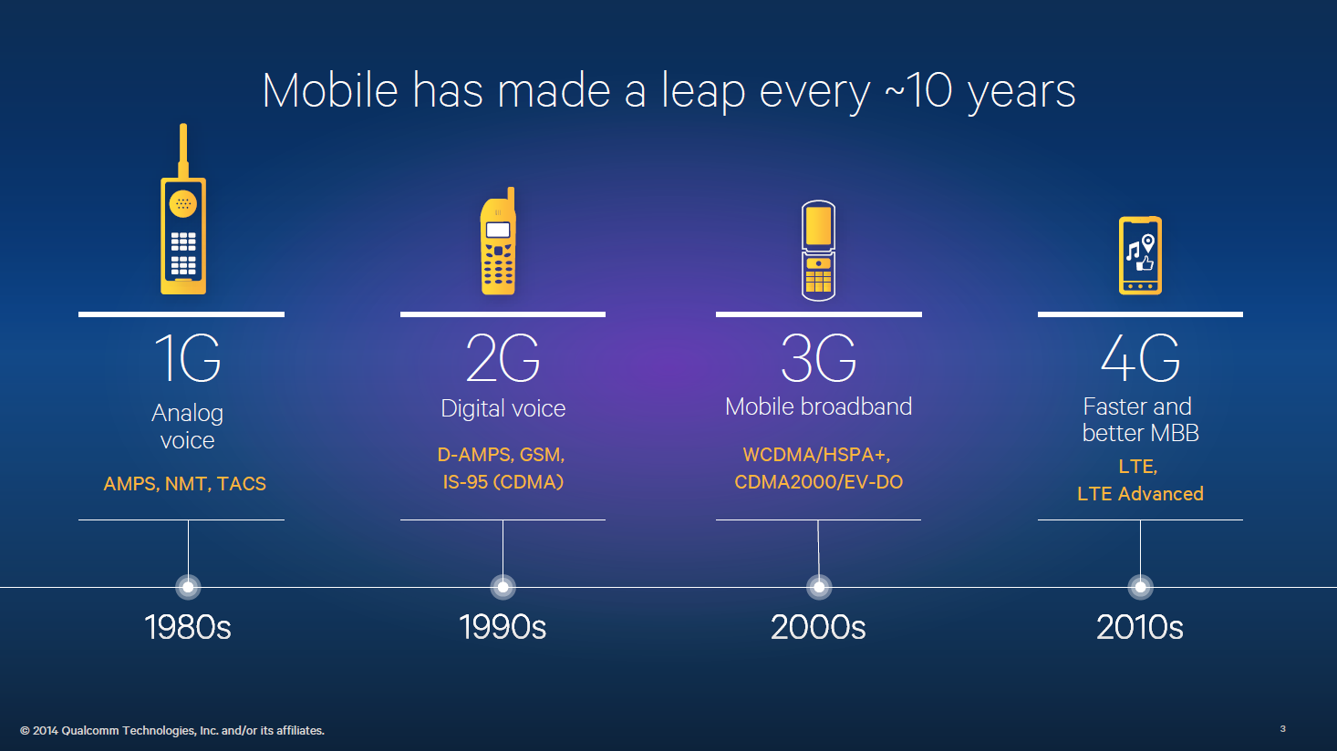
Cellular
Voice+Data
VoIP

Slide 4
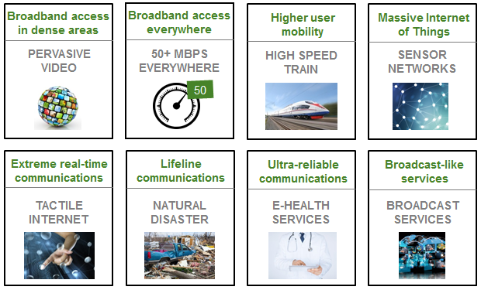
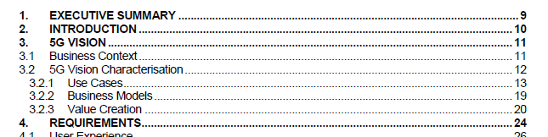
Starting point - ‘5G is different’
Service, application and business case-led definition
Source – NGMN White Paper, 2015 https://www.ngmn.org/de/5g-white-paper/5g-white-paper.html
5G Vision defined around Business Context, and Characterisation based on Use Cases, Business Models and Value Creation

Slide 5
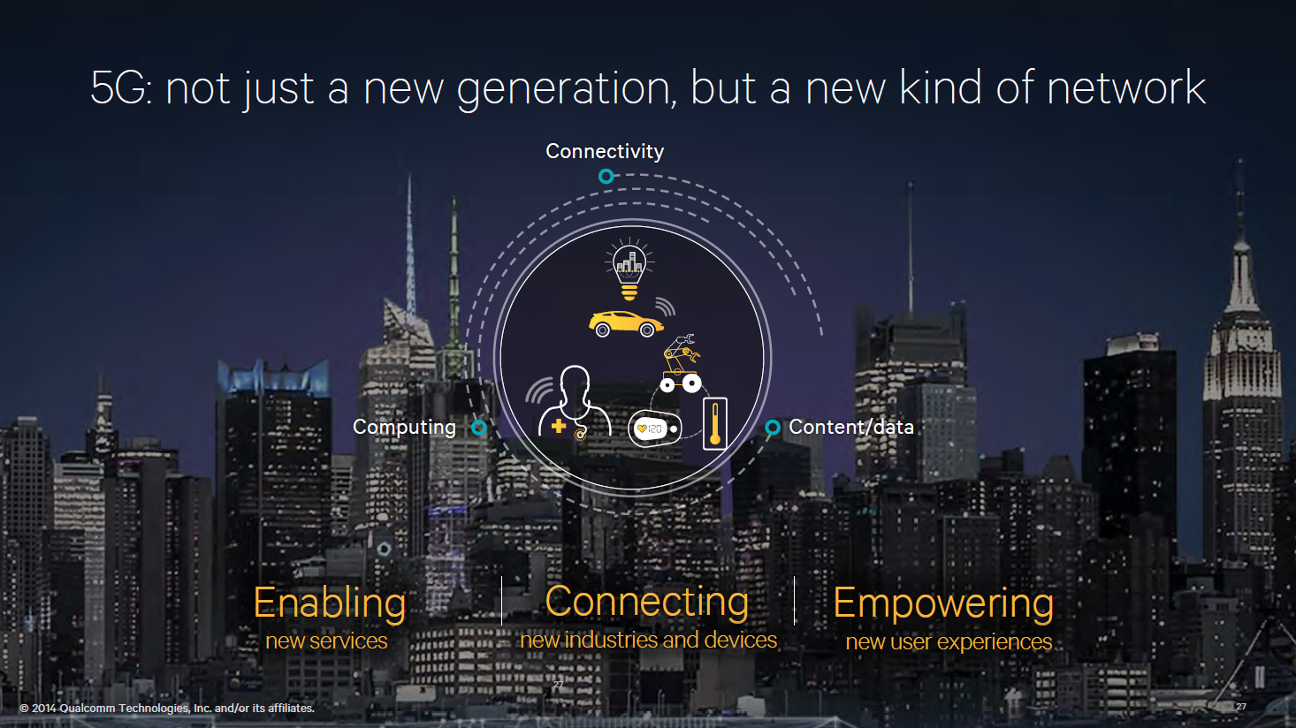

Slide 6
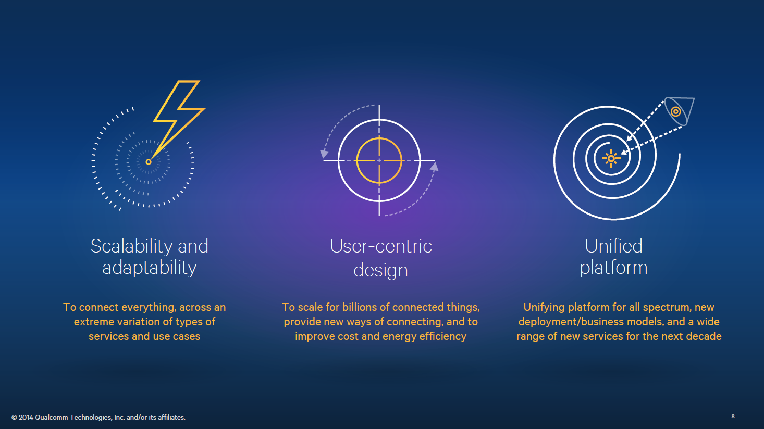

Slide 7
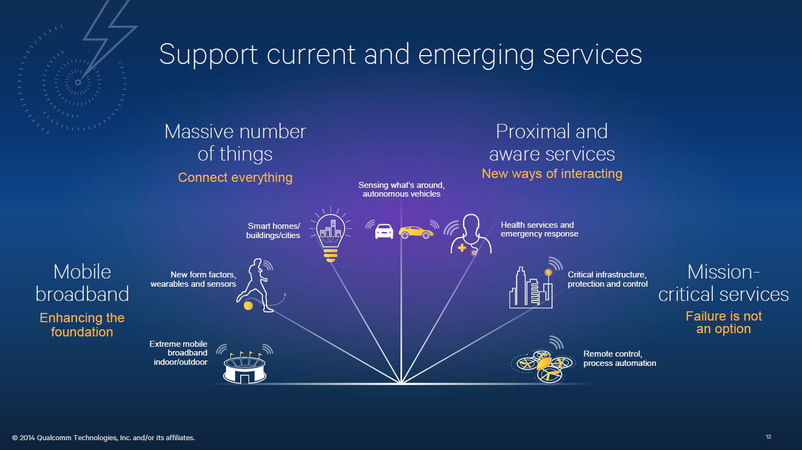

Slide 8
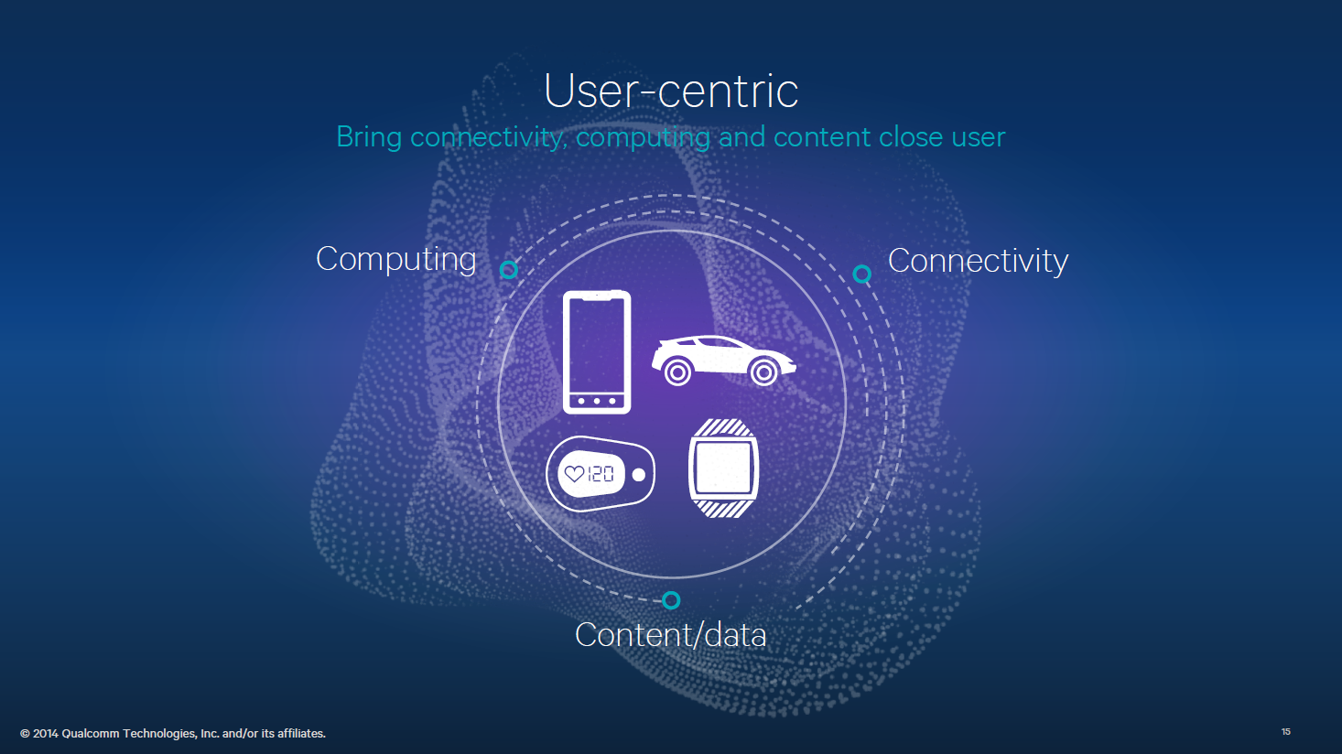
Notes:
Device is not just an end-point—integral part of the network
Expanded human abilities,Human-like interactions,Contextual personalization

Slide 9
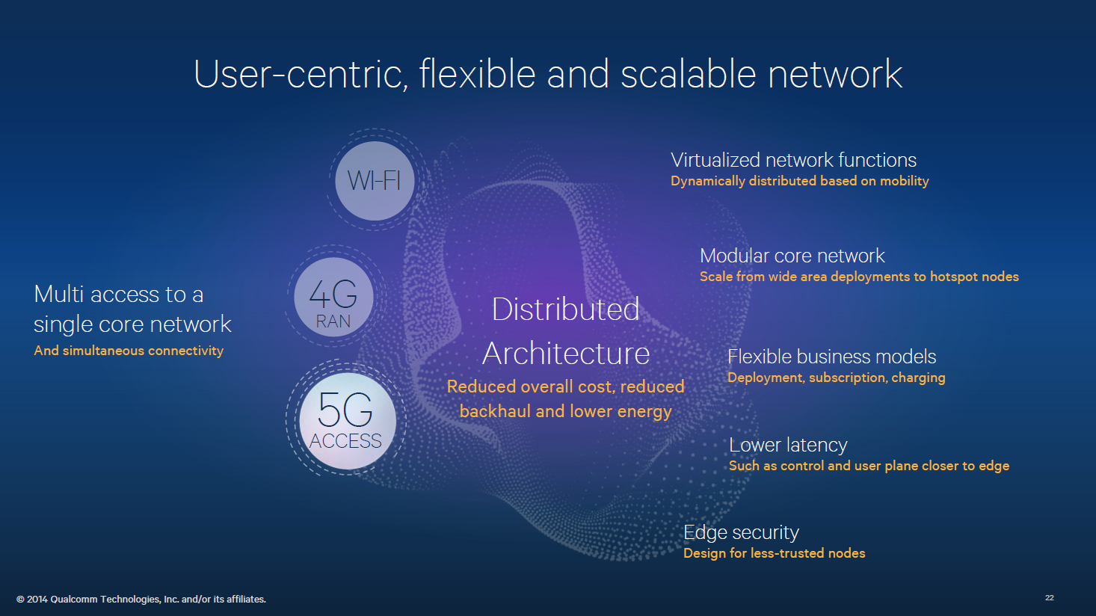

Slide 10
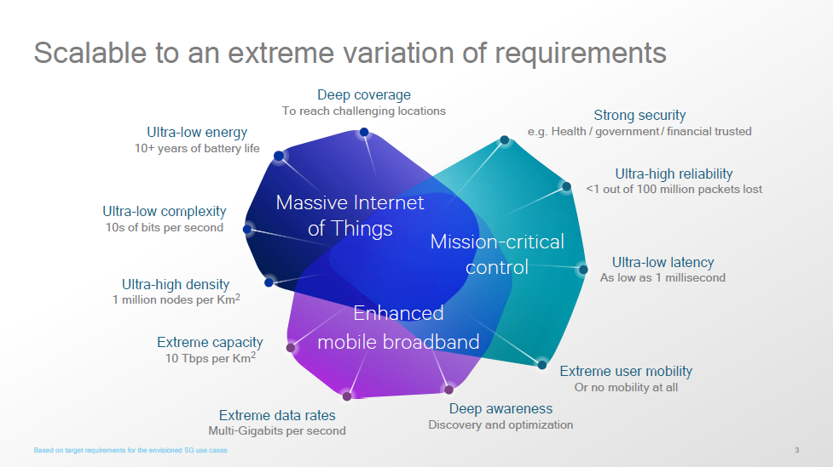

Slide 11
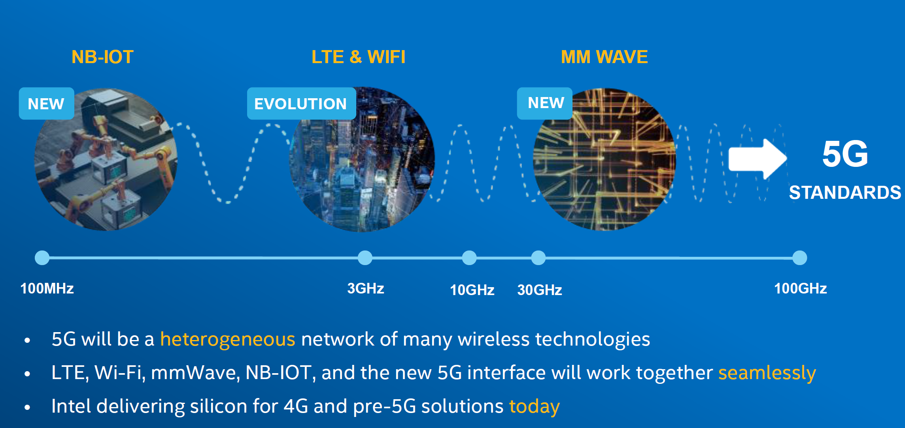

Slide 12
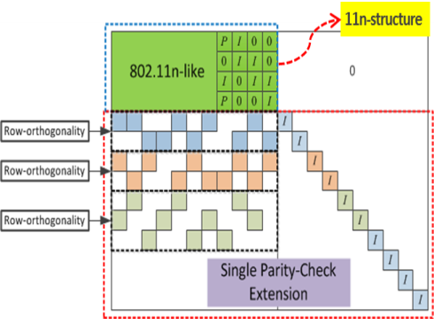
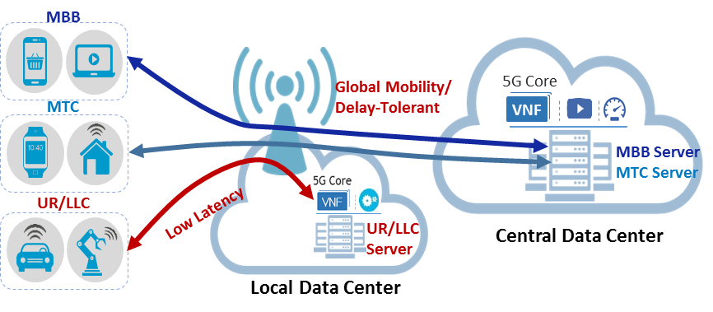
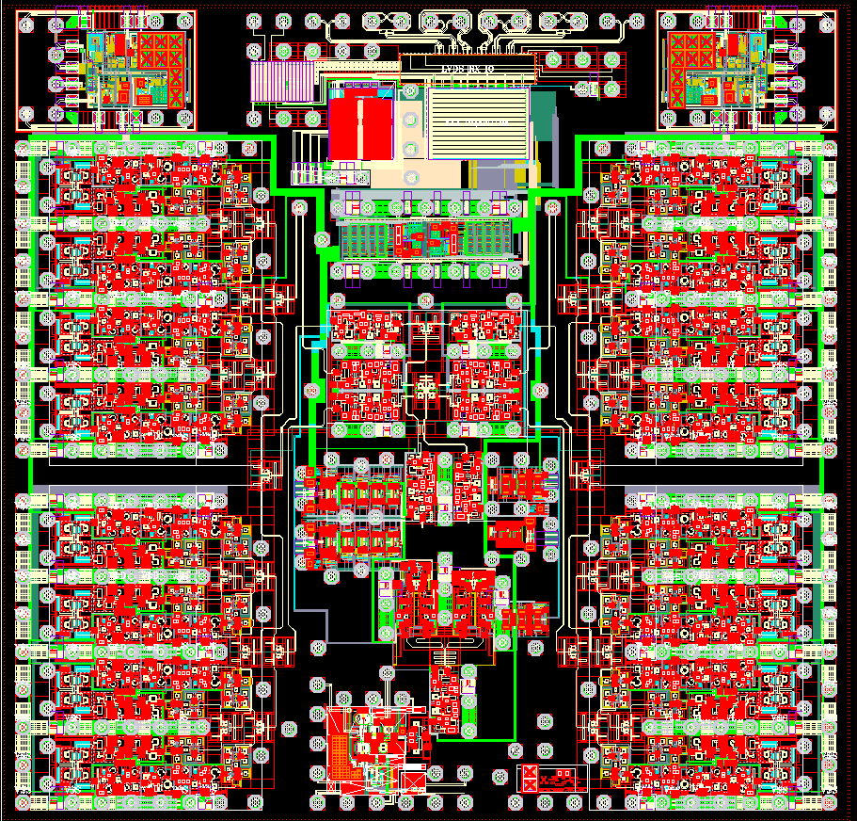
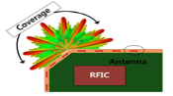









5G Service Enablers – meeting requirements
mmWave System/RFIC/Ant.
New Channel Coding
Network Slicing
700 MHz
3 GHz
18
27
30 GHz
Legacy Bands
New Bands
mmWave
RFIC
Wide
Coverage
Antenna
LDPC (Low-Density Parity-Check )
< 6 GHz Massive MIMO
Massive Connectivity (IoT)
Low Latency NW
Half
-Wavelength
Grant-based
Multiple Access
Grant-Free
Multiple Access
① Radio
Information
② TCP Rate
Control
eNB
3~4 Step
1 Step
eNB
UE
UE
Data
Mobile
BS
Server

Slide 13

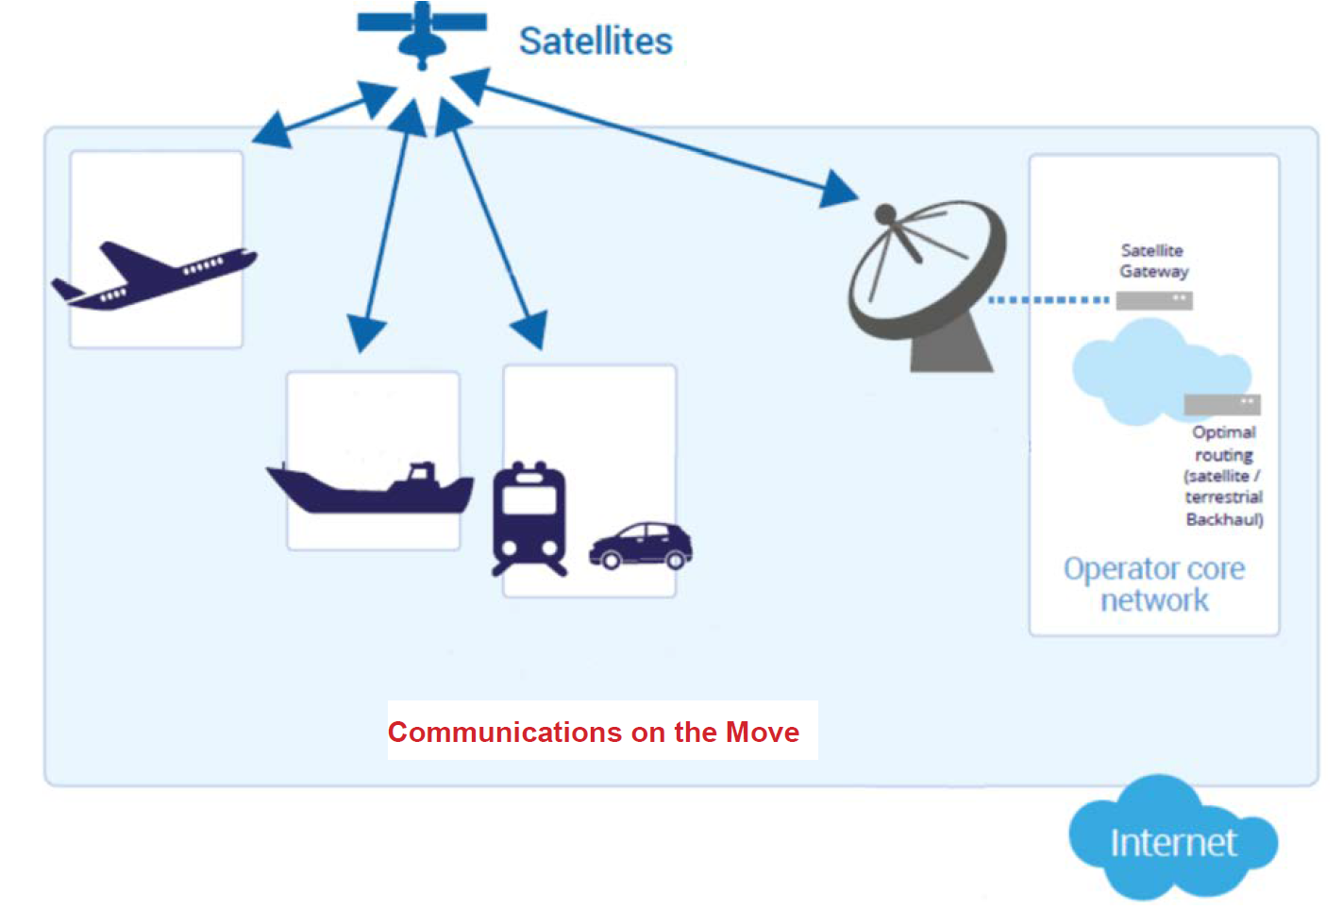
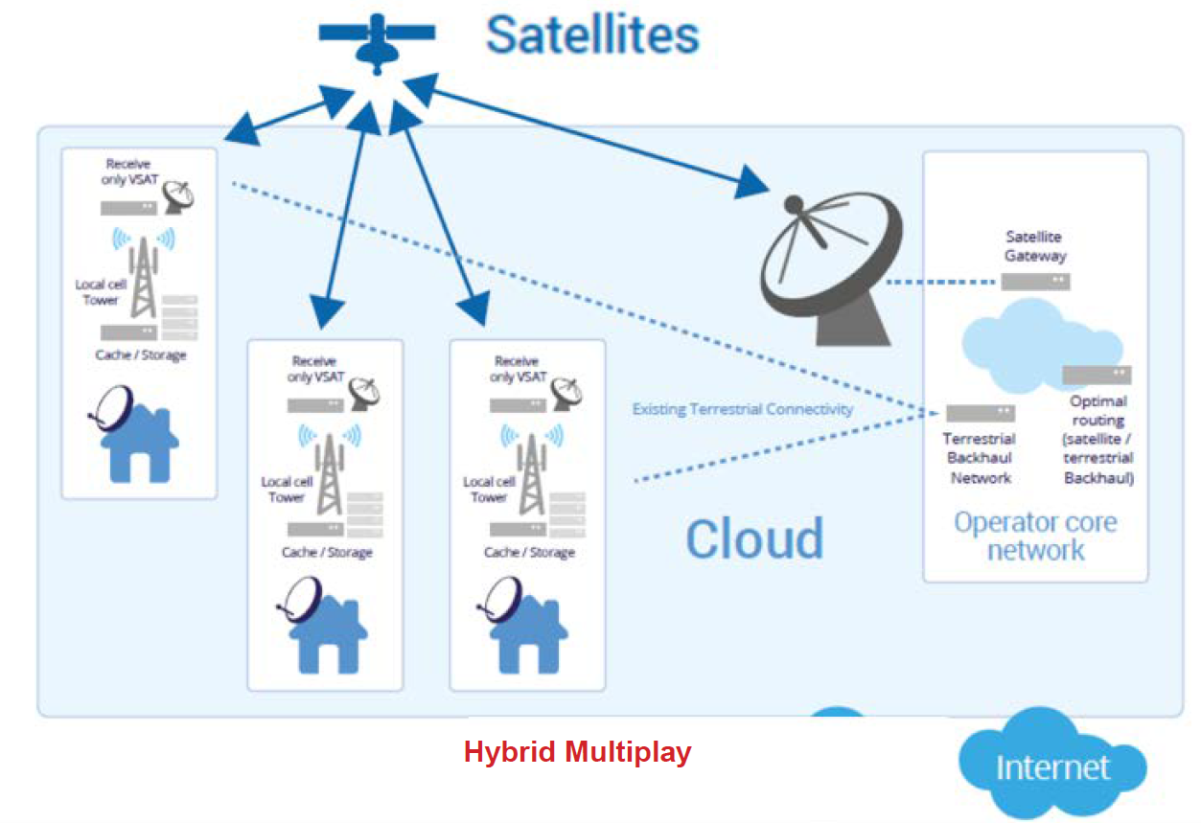
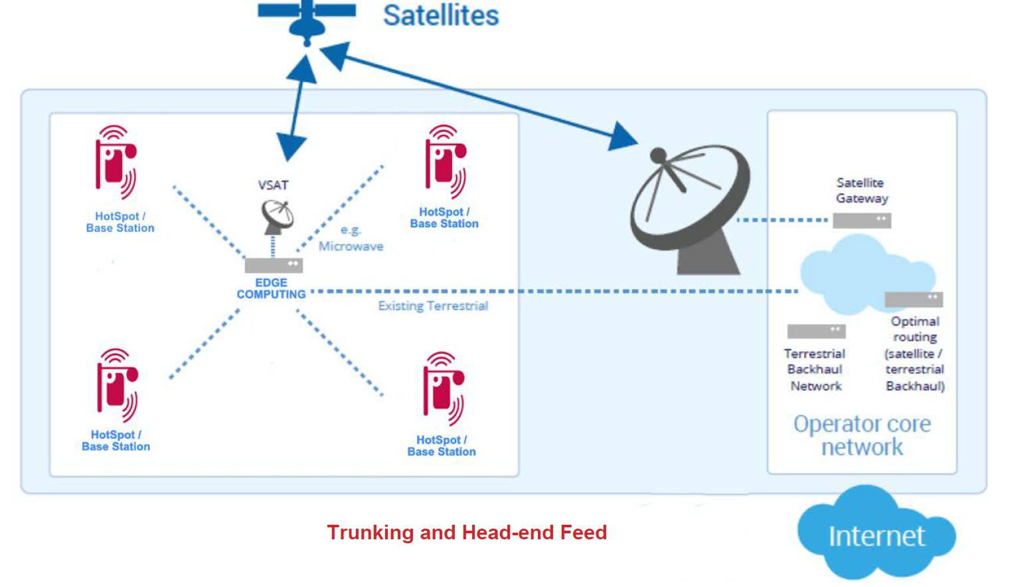
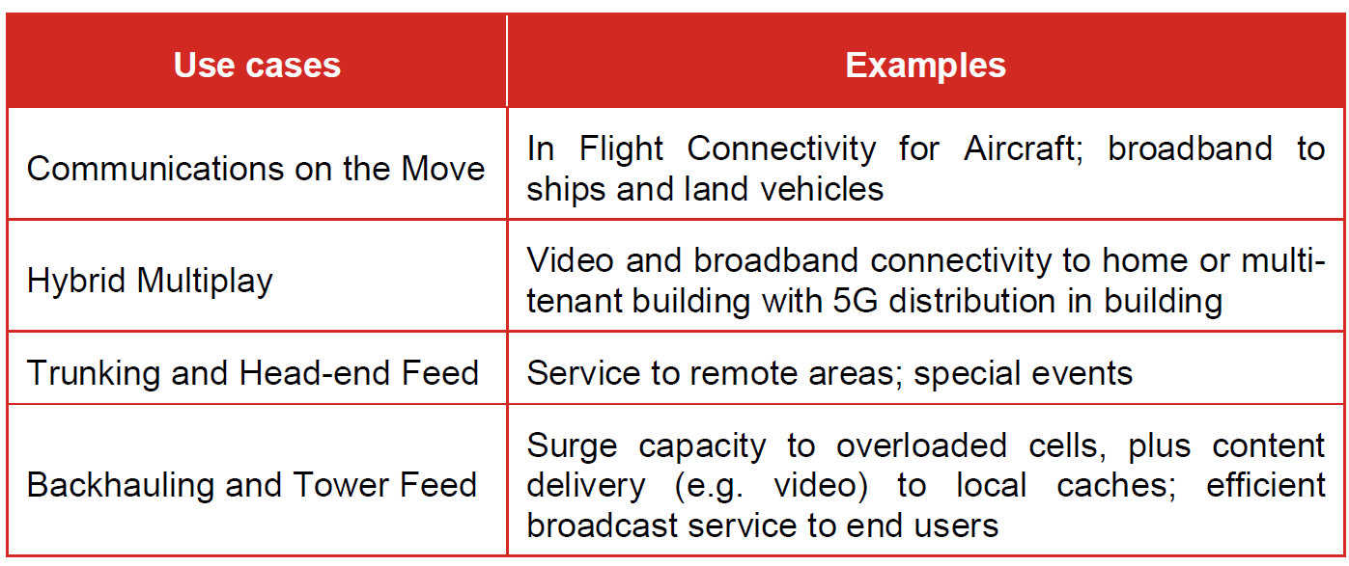
Innovation Enabling New Verticals

Slide 14
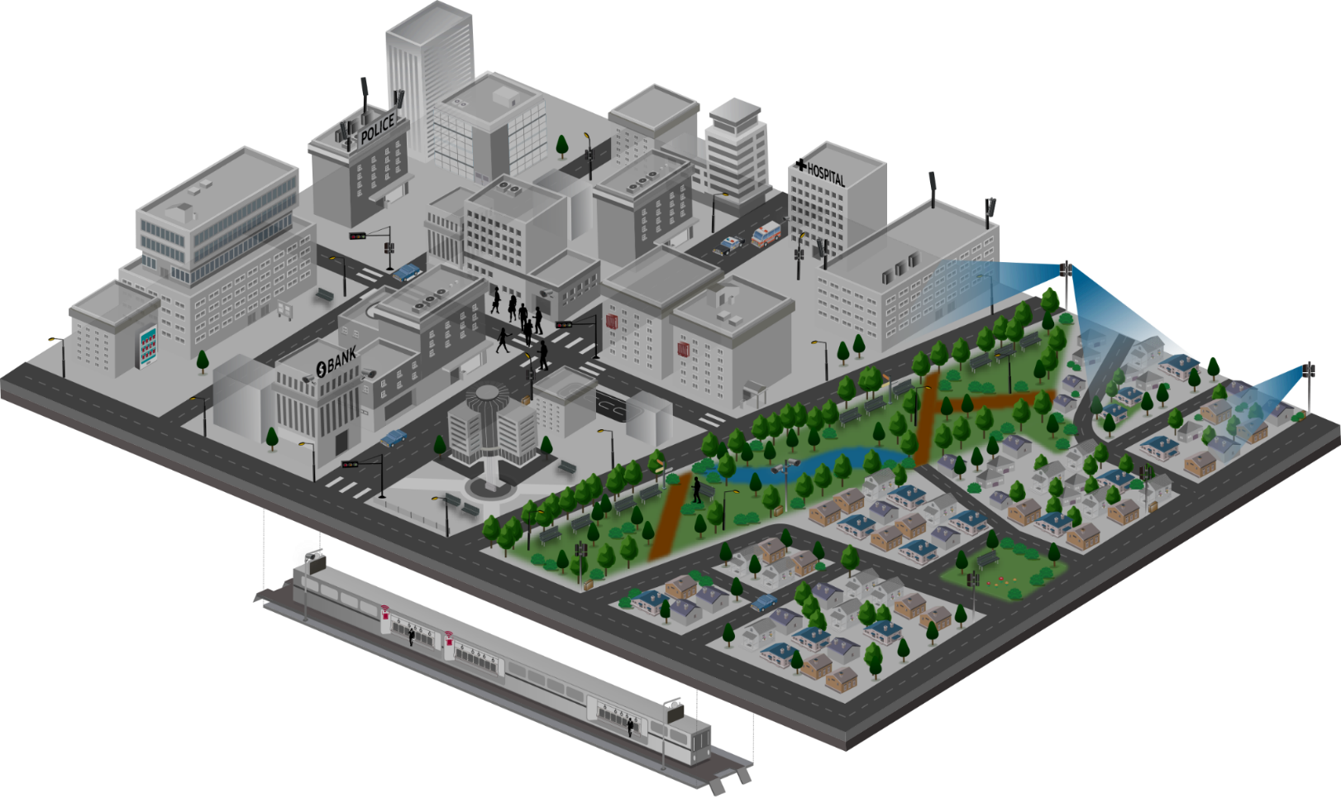














5G Service Scenarios
Key Scenarios to be Addressed throughout the Multiple Stages of 5G Development
1
Mission Critical Service
4
Fixed Broadband
· Full reliability & high availability
· Real-time responsiveness
· On-the-fly coverage scalability
for disaster situations
· Next-generation broadband
· Multi-Gbps peak throughputs
· Alternative to costly fibre
· New VAS possibilities for
fresh revenue generation
Requirements
Ambulance
10x bandwidth per connection
Low-ms latency
Five 9’s reliability
100% coverage
>10x connections
50Mbps per connection everywhere
1000x bandwidth/area
10 year battery life
Reduction in TCO
Autonomous driving
Vending machine
CCTV
CCTV
2
Massive IoT
3
Mobile Broadband
· Connectivity for a new wave of device types
· High density deployments
· Networks-as-a-Service to meet
each service provider’s needs
· Robust QoE / QoS management
· New revenue opportunities
CCTV
· Multi-Gbps peak throughputs
· Universal gigabit connectivity
· Unparalleled mobility support
· New service / application enablement
· Advanced big data analytics

Slide 15
Different contexts of the same environment
Requirements
Applications
Customer segments
MNO biz model
10x bandwidth per connection
Low-ms latency
Five 9’s reliability
100% coverage
>10x connections
50Mbps per connection everywhere
1000x bandwidth/area
10 year battery life
Reduction in TCO
Enhanced Mobile BB
Connected vehicles
AR/VR
S-UHD/3D Video
Haptics/Sensing
Massive IoT
Remote machine control
Mission critical services
Fixed-wireless access
…
Consumer
Auto industry
Health
Industry 4.0
Agriculture
Smart City/Public sector
Smart building
Utilities
Education
Transport
…
B2C
B2B
B2B2C

Slide 16
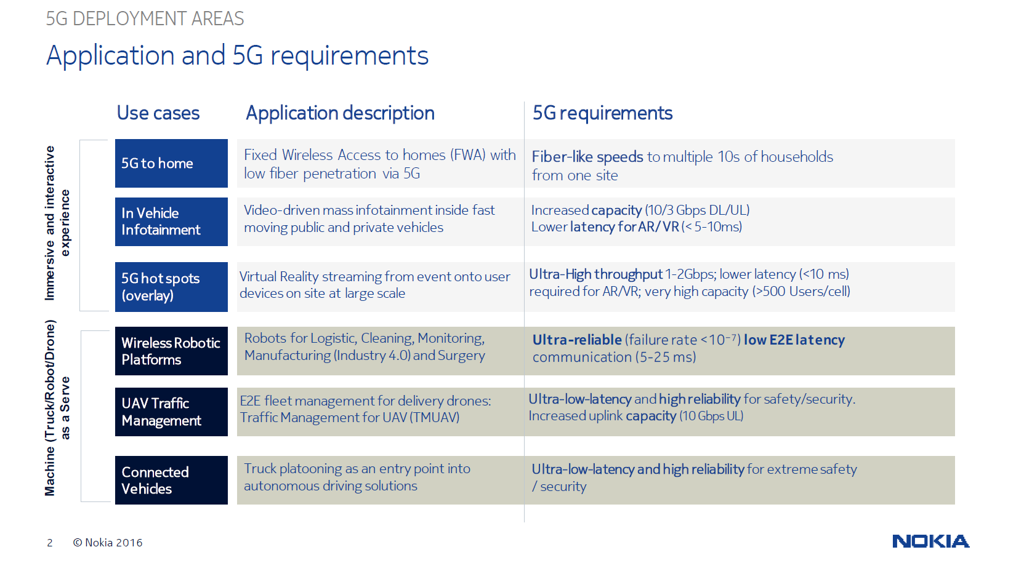

Slide 17
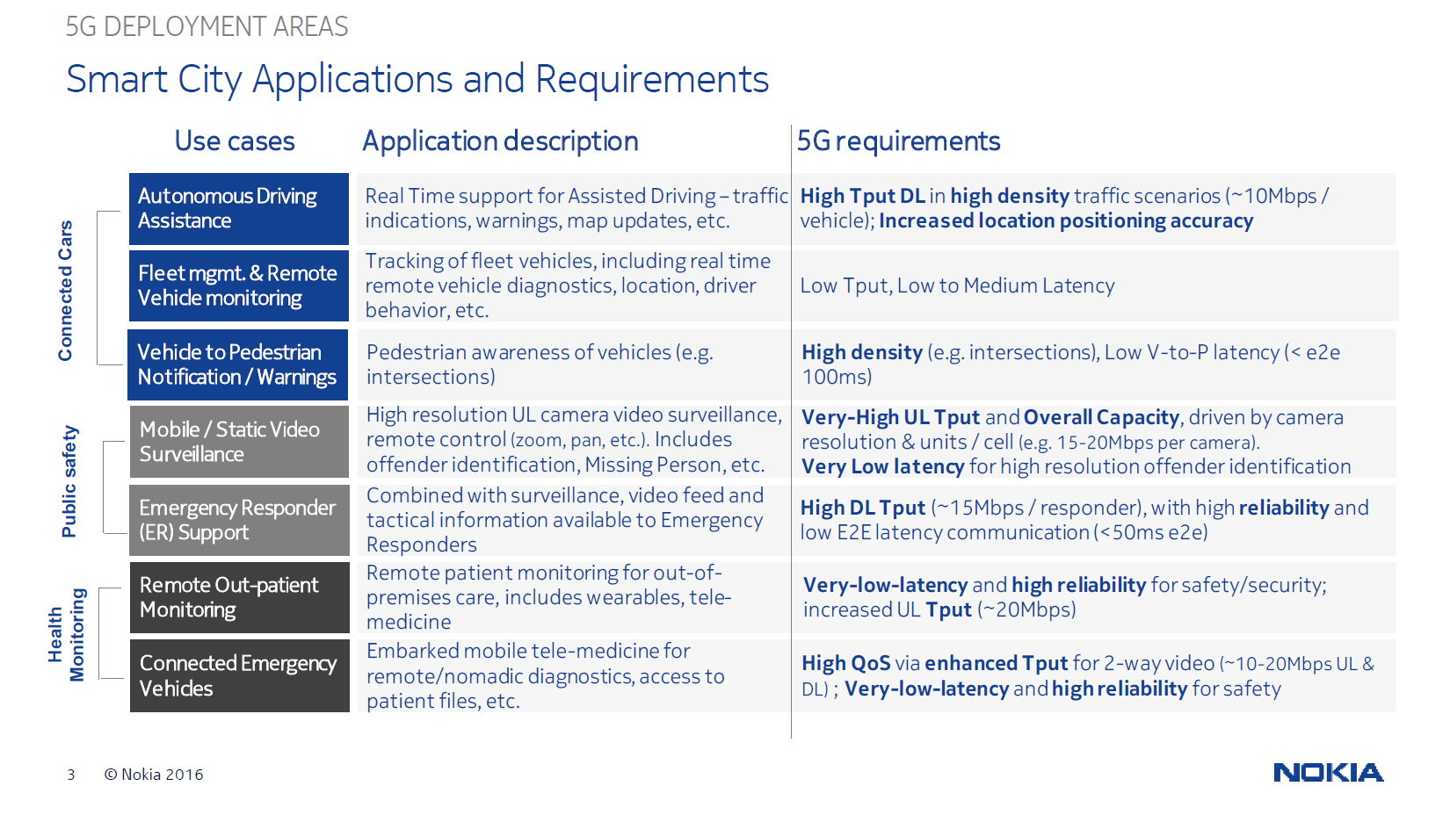

Slide 18
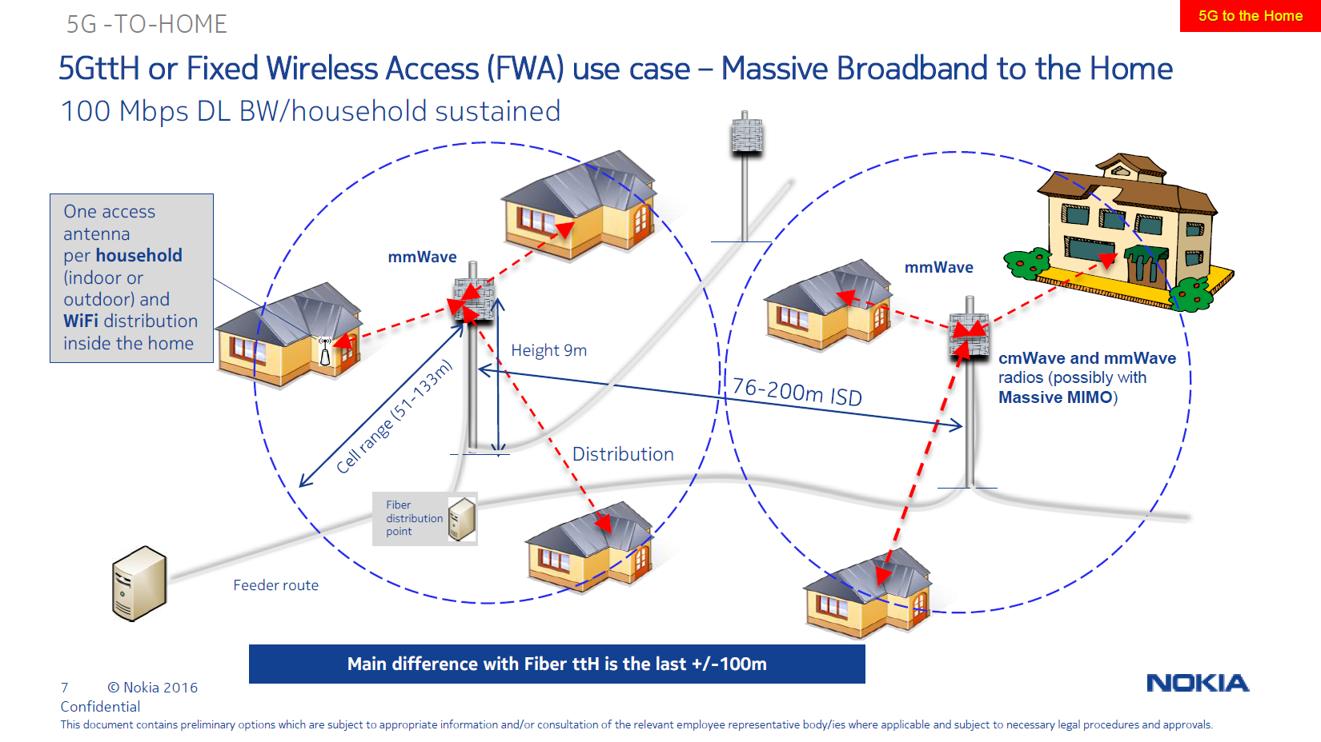

Slide 19
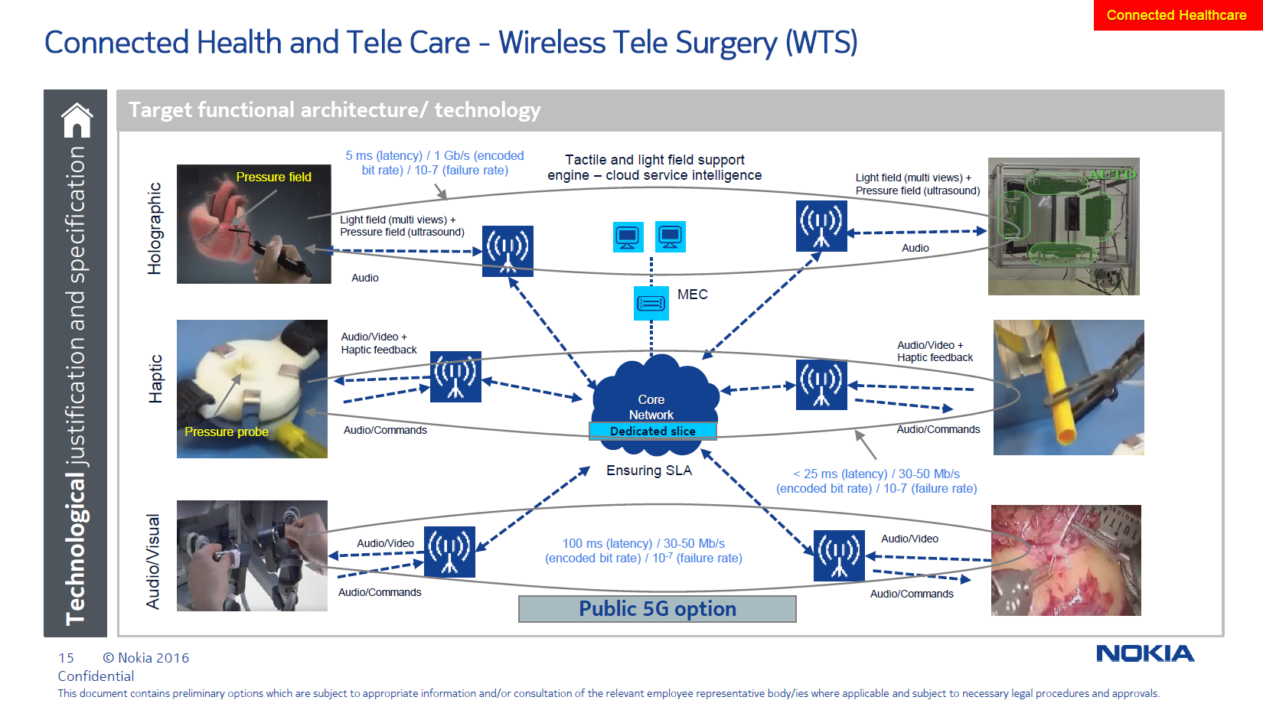

Slide 20
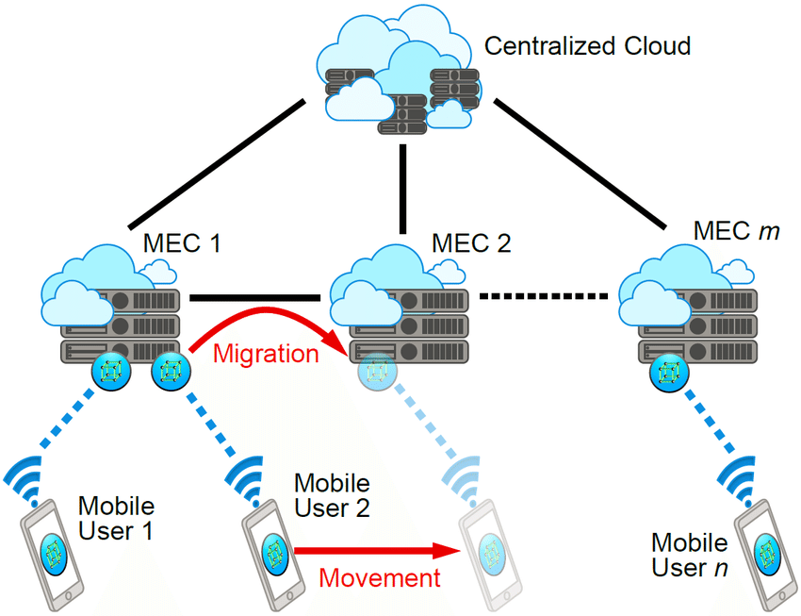

Slide 21
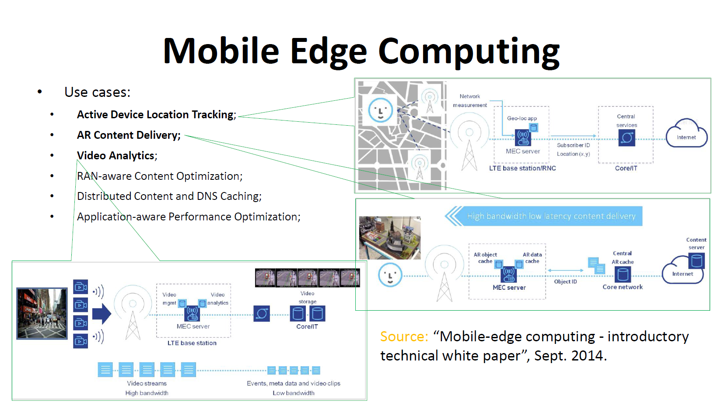

Slide 22
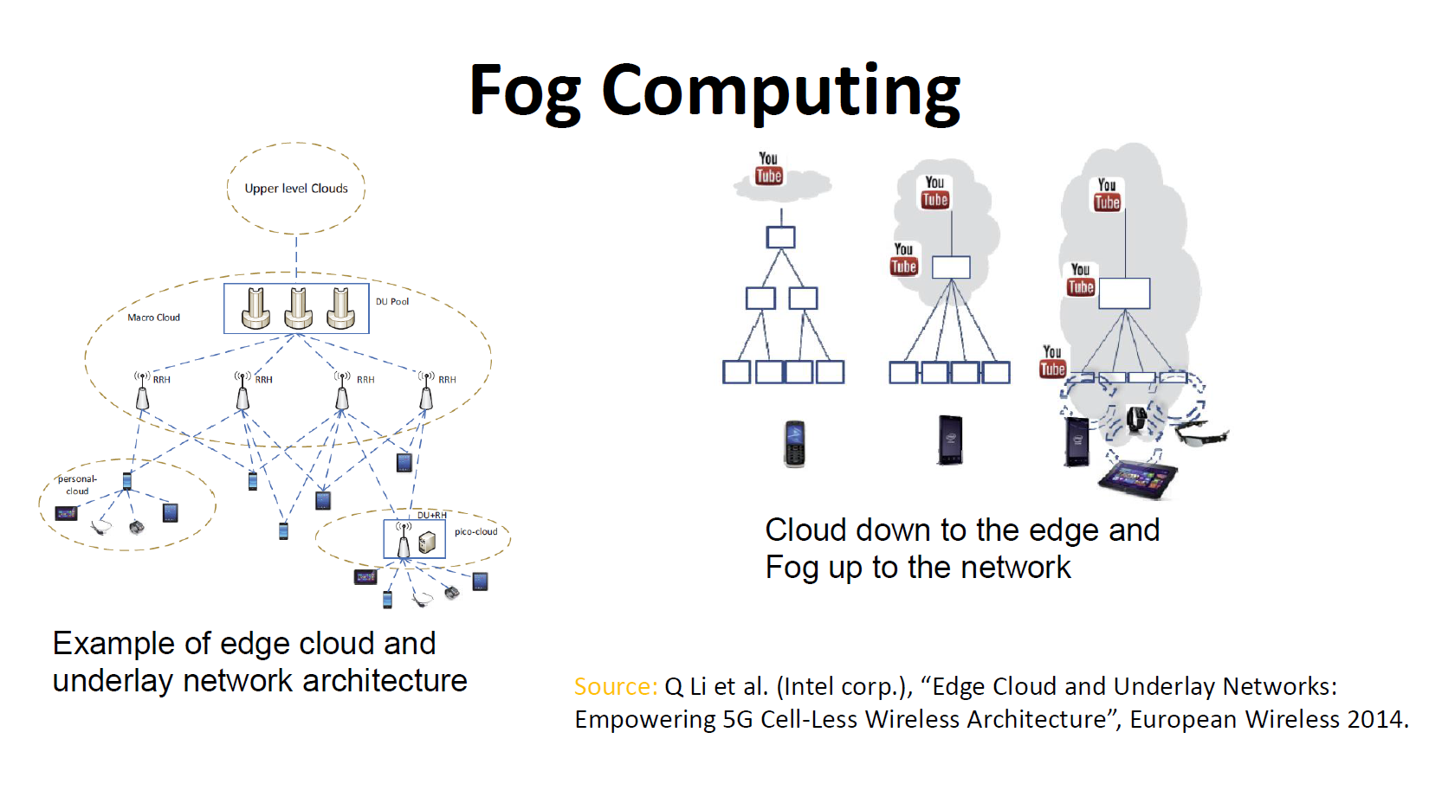

Slide 23
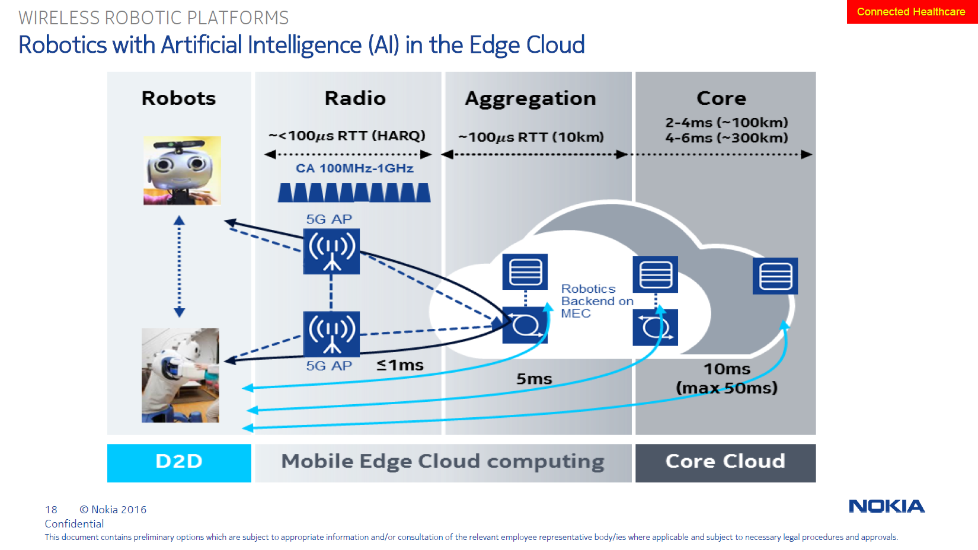

Slide 24
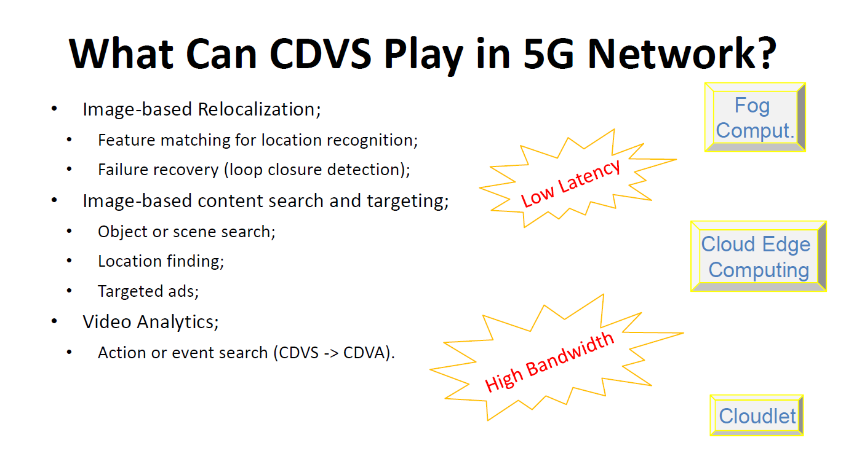

Slide 25
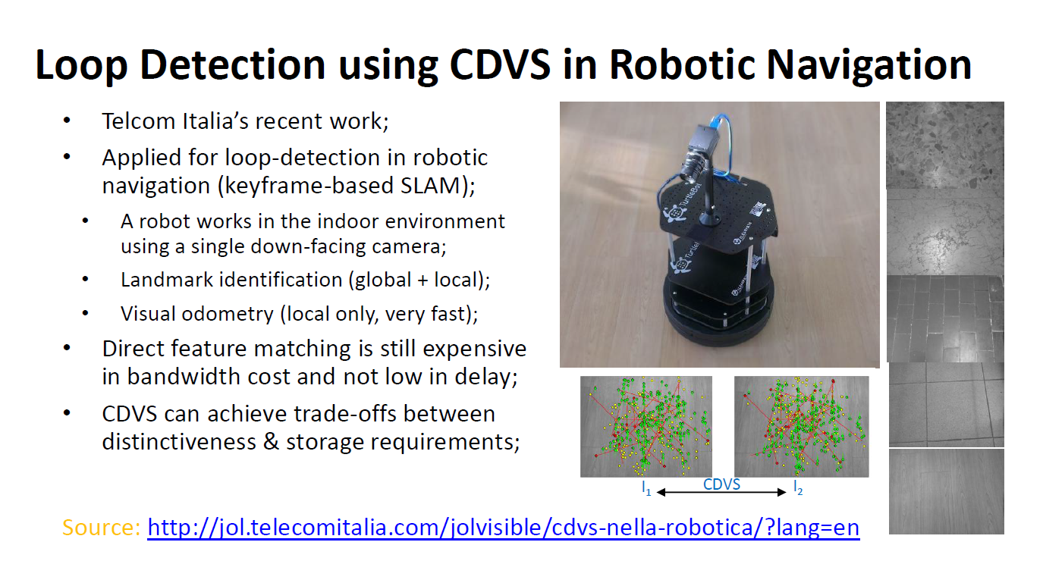

Slide 26
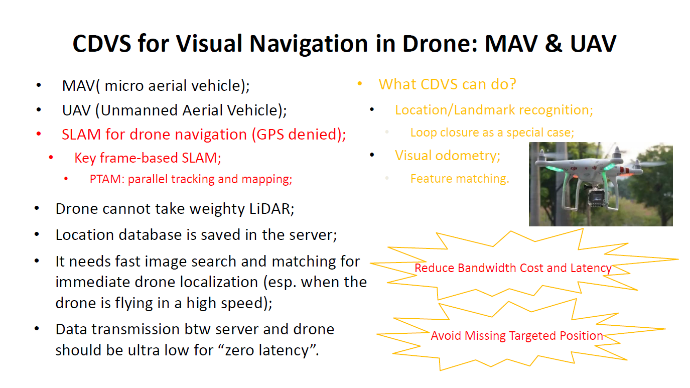

Slide 27
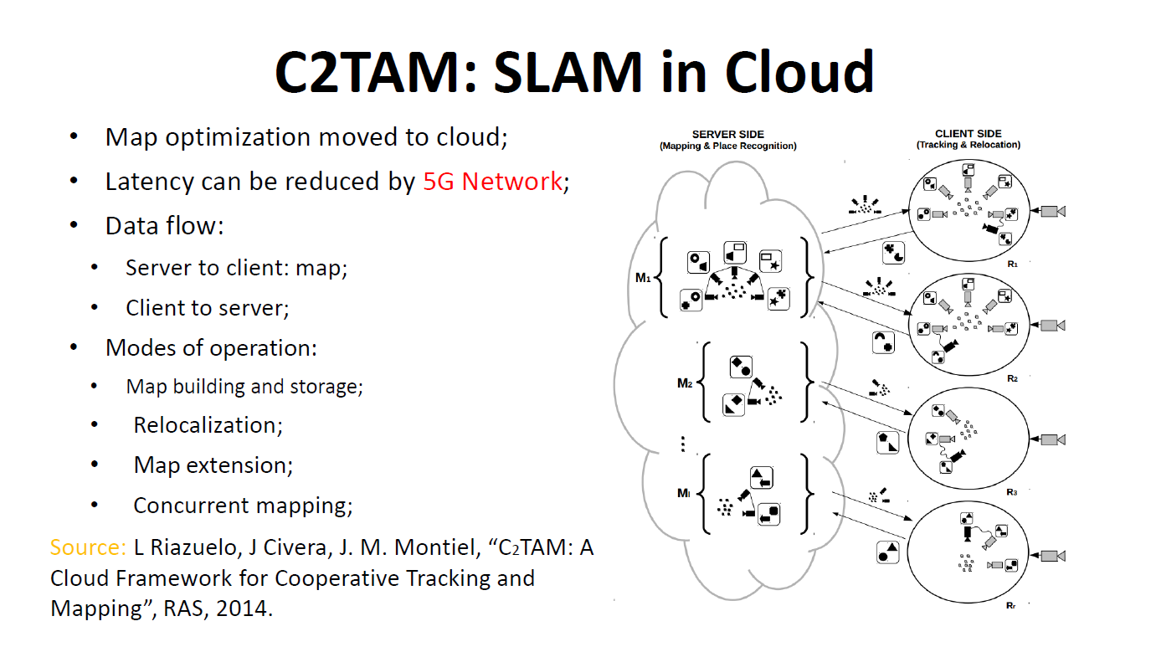

Slide 28
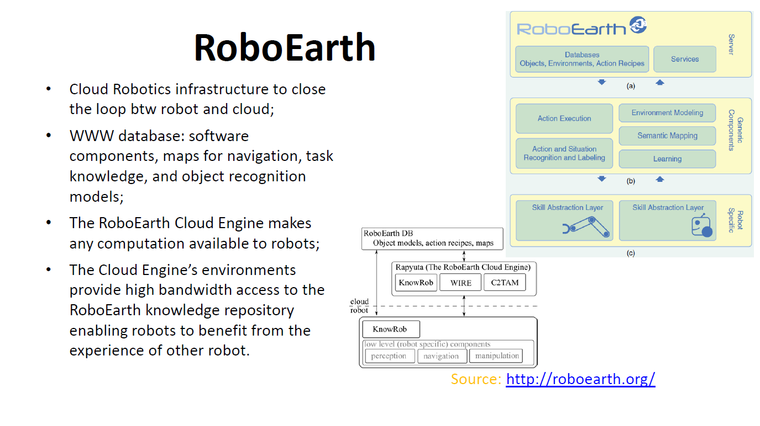

Slide 29
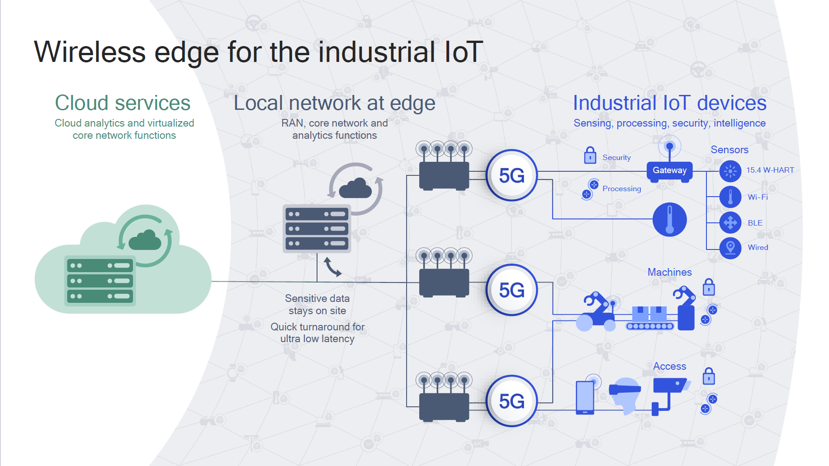

Slide 30


Slide 31
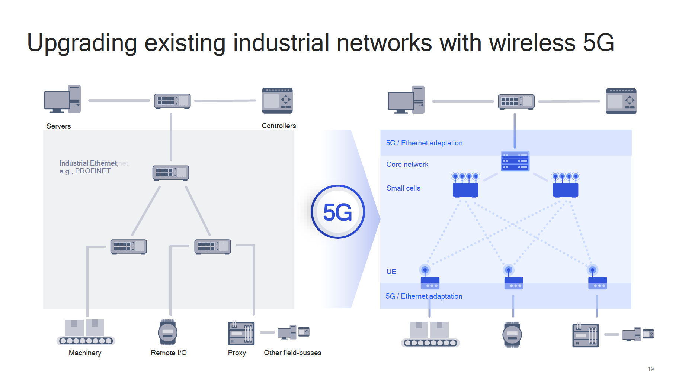
Private network for security

Slide 32

Consequences if we take all as read…
1ms latency for AR, VR, remote surgery is pointless without a video codec that runs significantly faster than 1000 frames per second.
TCP/IP is not fit for purpose. Packet loss handling will break a lot of 5G use cases
…and neither is GTP. Internet of Things needs ‘Internet to the Thing’ without a proprietary connectivity network in the way.
‘Driverless’ autonomous cars are great, as long as they are ALL autonomous. There is a massive backward compatibility issue when some cars are driverless and others aren’t.
Existing Roaming model won’t cut it… but we have been trying to change Roaming for years. It is not technology that stops it changing.

